Slide 1
The Bulk Forming Processes: Forging
Lecture 14

Slide 2
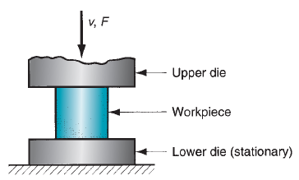
Forging Process
A deformation process in which the workpiece is compressed between two dies, using either impact load or hydraulic load (or gradual load) to deform it.
It is used to make a variety of high-strength components for automotive, aerospace, and other applications. The components include engine crankshafts, connecting rods, gears, aircraft structural components, jet engine turbine parts, etc.

Slide 3
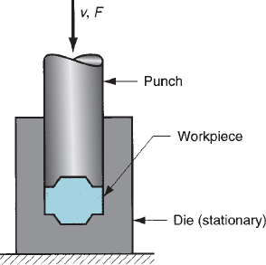
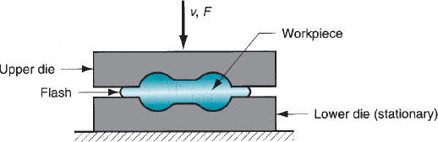
Classifications of Forging
Based on temperature:
(a) cold forging, (b) warm forging, and (c) hot forging
Based on presses:
(a) impact load => forging hammer; (b) gradual pressure => forging press
Based on the type of forming:
(a) Open die forging, (b) impression die forging, (c) flashless forging
Open die forging
Impression die forging
Flashless forging

Slide 4
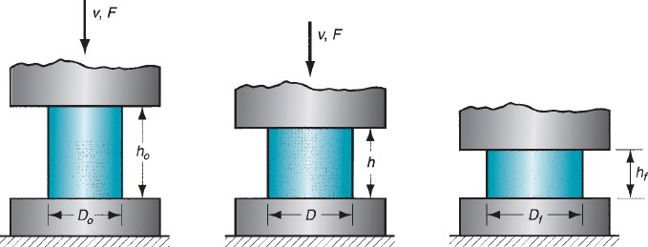
Open Die Forging
A simple example of open die forging is the compression of a billet between two flat die halves, which is like a compression test. This is also known as upsetting or upset forging.
Under ideal conditions, where there is no friction between the billet and die surfaces, homogeneous deformation occurs. In this, the diameter increases uniformly throughout its height.
Start of compression Partial compression
Completed compression

Slide 5
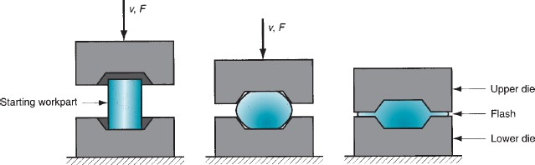
Impression Die (Closed Die) Forging
Closed die forging, called impression die forging, is performed in dies which has the impression that will be imparted to the workpiece through forming.
In the intermediate stage, the initial billet deforms partially, giving a bulged shape.
During the die full closure, the impression is fully filled with the deformed billet and further moves out of the impression to form flash.
In a multi-stage operation, separate die cavities are required for shape change.
In the final stage, actual shape modification is observed. When drop forging is used, several blows of the hammer may be required for each step.
Example: Coining
Starting stage
Intermediate stage
Final stage with flash formation

Slide 6
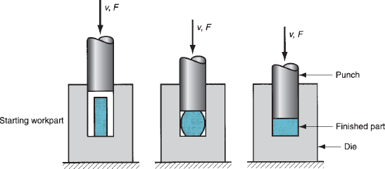
Flashless Forging
Flashless forging: the most important thing is that the workpiece volume must equal the space in the die cavity within a very close tolerance.
If the starting billet size is too large, excessive pressures will cause damage to the die and press. If the billet size is too small, the cavity will not be filled.
Three stages of Flash Forging
Suitable to make simple and symmetrical part geometries, and to work with materials such as Al, Mg, and their alloys.

Slide 7


